Slide 1
University Of Technology
Department of Biomedical Engineering
Biomedical Optics
Submitted by :
Assistant Lecture Israa Fawzi Hasan
2023-2024

Slide 2
1- Geometrical optics
Geometrical optics is a branch of optics that deals with the behavior of light rays and their propagation in media (the behavior of light rays in lenses, mirrors, and prisms).
Geometrical optics is fundamental to optical imaging. It is widely used in various fields, including physics, engineering, visual science.

Slide 3
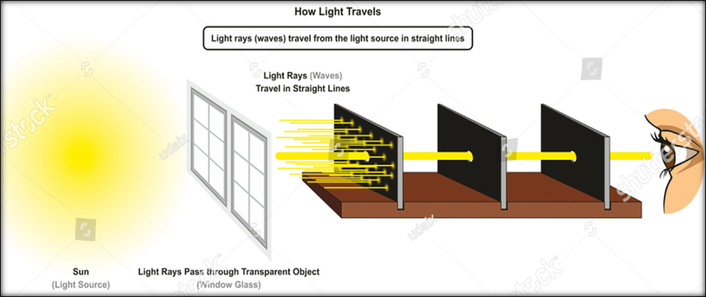
In ray optics, light is described in terms of "rays" and it is assumed that light travels in a straight line.

Slide 4
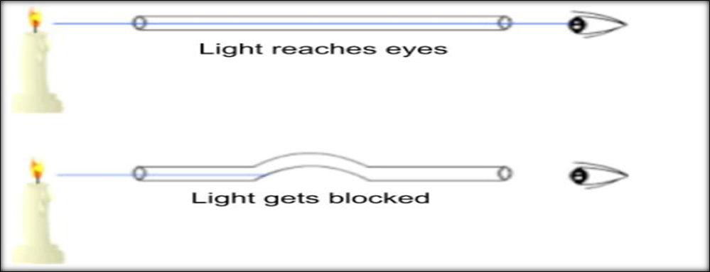
Reflection, refraction, and dispersion are some of the properties of light in ray optics.

Slide 5
1)Reflection: is one of the fundamental properties of light, especially in the context of ray optics. It occurs when light encounters the boundary between two different optical media, such as air and a mirror or air and water, causing the light to change direction.
The law of reflection states that “The angle of incidence is equal to the angle of reflection".

Slide 6
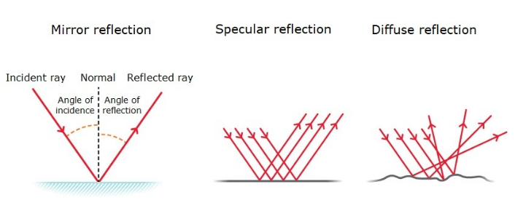
a. Specular Reflection: is light reflects from the surface (the surface is smooth and shiny, like glass, water or polished metal), where that lead to the light rays will reflect at the same angle as it hit the surface.

Slide 7
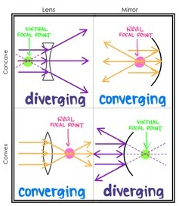
b. Diffuse Reflection: is light reflects from the surface (the surface is a rough surface), where that lead to reflected light rays scatter in all directions.
Reflection is used in various optical instruments like mirrors, telescopes, and microscopes.

Slide 8
2) Refraction: is a fundamental phenomenon in optics, and it occurs when light (or any wave) passes from one optical medium into another with different properties, such as a change in the medium's optical density. The speed of light or any wave is indeed dependent on the properties of the medium through which it travels.

Slide 9
Law of Refraction is “Snell’s Law” is usually stated as:
Where:
θ_{i} is angle of incidence.
θ_{r} is angle of refraction.
n₁, n₂ are refractive indices of the two media.
n₁sinθ_{i} = n₂sinθ_{r}

Slide 10
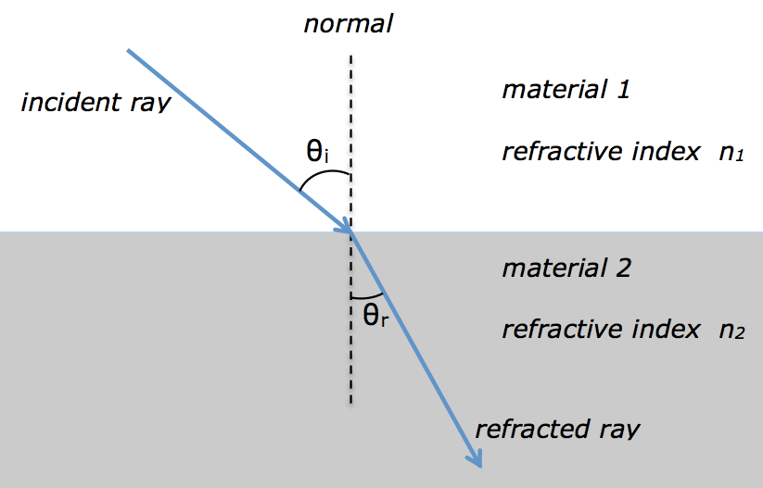

Slide 11
The refractive index of water is 1.33 whereas the refractive index of air is 1.00029.
When light goes from a low refractive index medium to a high refractive index medium, the reflection undergoes a 180-degree phase change, but when it goes from a high refractive index medium to a low refractive index medium, it does not undergo a phase change.
Electromagnetic waves are transverse waves, meaning that they oscillate or vibrate perpendicular (at right angles) to the direction in which they propagate. This characteristic is one of the key features of electromagnetic waves and is in contrast to longitudinal waves, where the oscillations are parallel to the direction of wave propagation.

Slide 12
3) Interference
Interference is a phenomenon in physics that occurs when two or more waves superpose (overlap) at a given point in space and time.
a. Constructive Interference: Constructive interference occurs when two or more waves are in phase, meaning that their peaks and troughs align with each other. When these waves superpose, their amplitudes add together, resulting in a wave with a greater amplitude. This leads to reinforcement and the creation of a wave with a higher intensity.

Slide 13
b. Destructive Interference: Destructive interference occurs when waves are out of phase, meaning that their peaks align with troughs. When these waves superpose, their amplitudes subtract from each other, leading to cancellation. This results in a wave with reduced or zero amplitude at the point of interference.

Slide 15
The laws of thermodynamics tell us that energy cannot be destroyed, but these two waves, both carrying energy, seem to briefly disappear when they interfere. To understand what is actually happening we must look at the energy in a wave as it vibrates.

Slide 16
Eikonal equation: is a non-linear first-order partial differential equation that is used in wave propagation problems, particularly in the context of ray theory. It is an approximation to the scalar wave equation, and it is used to describe the behavior of waves, such as light and sound waves, as they travel through a medium.
The solution of the eikonal equation is the fastest travel time to a point in the medium from the boundary of the medium. The eikonal equation is widely used in various fields, including optics, seismology, and medical imaging, radar, and sonar, among others. The eikonal equation is also used in the study of Maxwell's equations and in the theory of geometrical optics.

Slide 17
The Eikonal Equation is the “F = ma” of ray optics. Its solutions describe the paths of light rays through complicated media.
F: The force acting on an object.
m: The mass of the object.
a: The acceleration of the object.
This equation is commonly known as Newton's second law of motion and is used to describe the motion of objects under the influence of forces.

Slide 18
The classical Eikonal equation in geometric optics is a differential equation of the form:

Slide 19
Optical path length (OPL): is a term used in optics to describe the length that light needs to travel through air to create the same phase difference as it would have when traveling through some homogeneous medium. OPL is an important concept in microscopy and other optical applications. The formula for calculating optical path length (OPL) is: OPL = n × d
Where: n is the refractive index of the medium.
d is the geometric length of the path light follows through the medium.

Slide 20
In a medium of constant refractive index, n, the OPL for a path of geometrical length s is just
OPL = n × s
If the refractive index varies along the path, the OPL is given by a line integral where n is the local refractive index as a function of distance along the path. This is expressed as:

